Slide 1
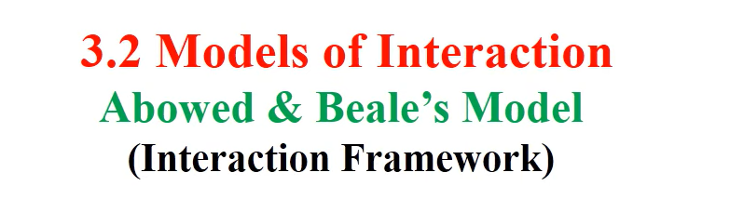

Slide 2
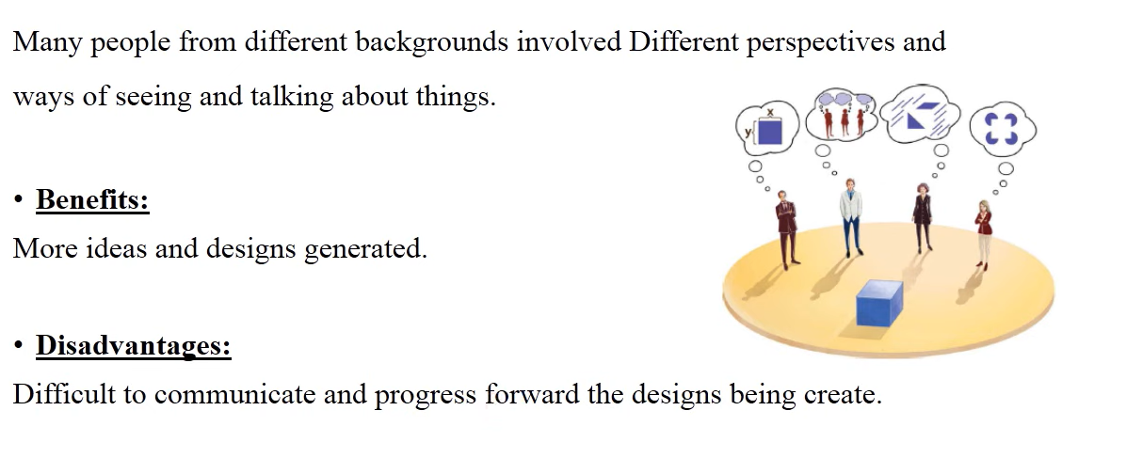
Working in Multidisciplinary Field

Slide 3
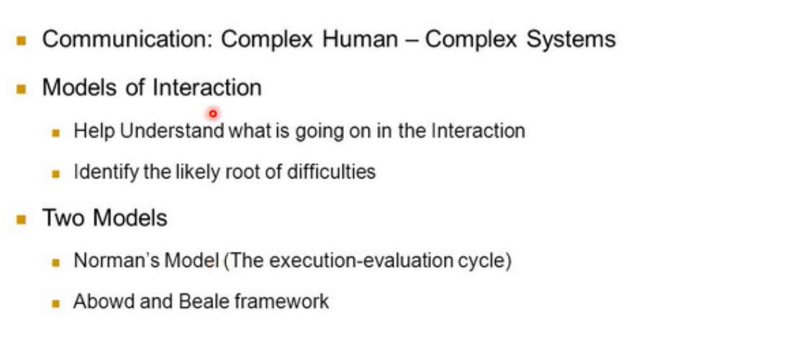
Models of Interaction

Slide 4
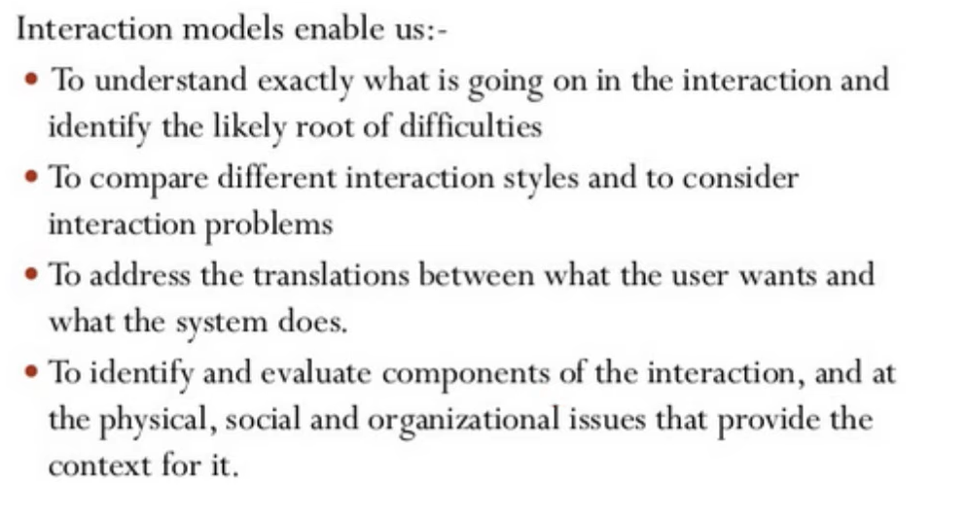
Why Models of Interaction?

Slide 5
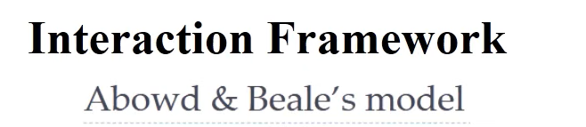
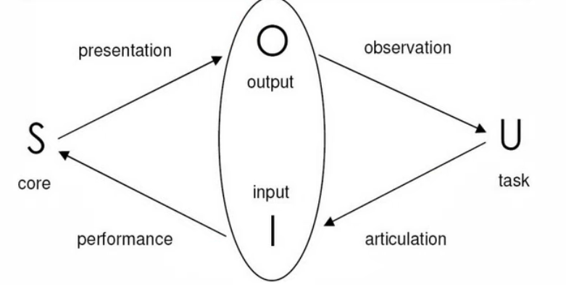

Slide 6

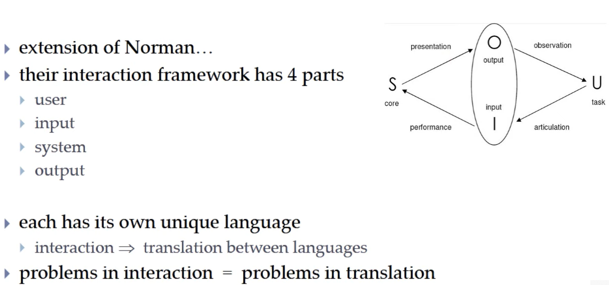

Slide 7

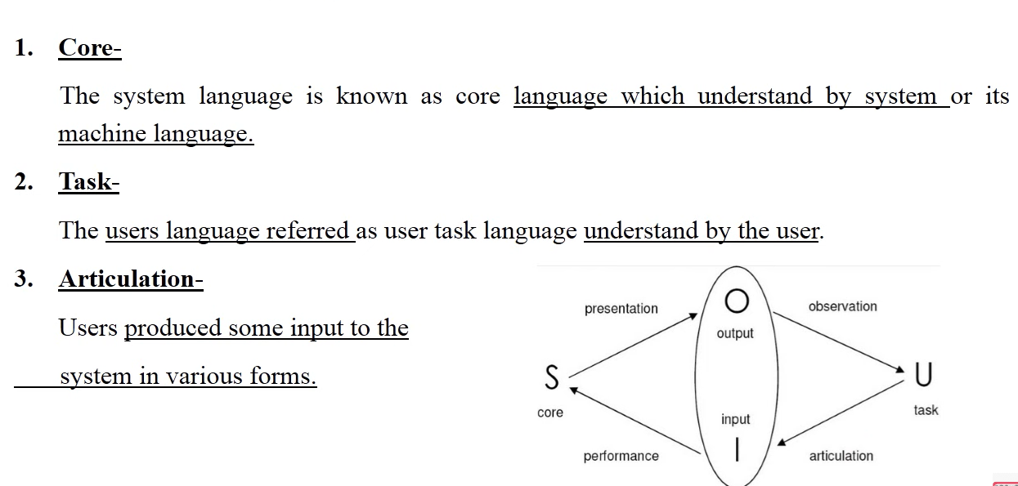

Slide 8
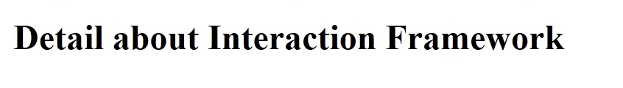
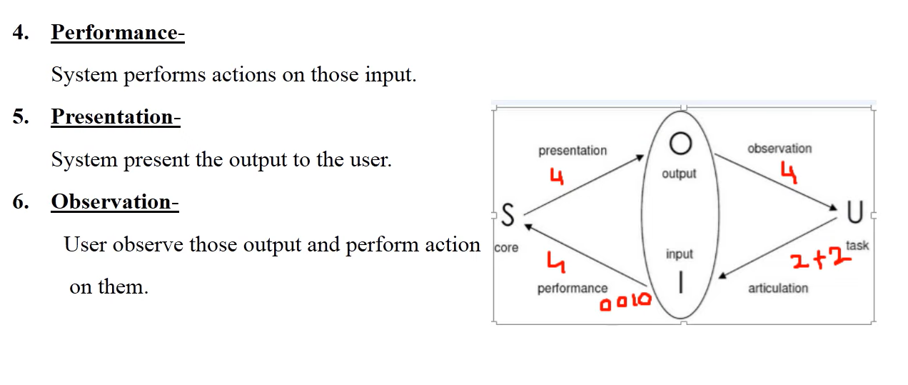

Slide 9
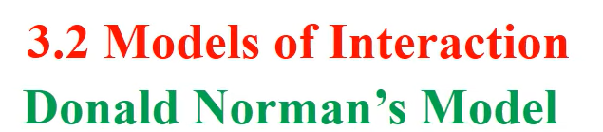

Slide 10

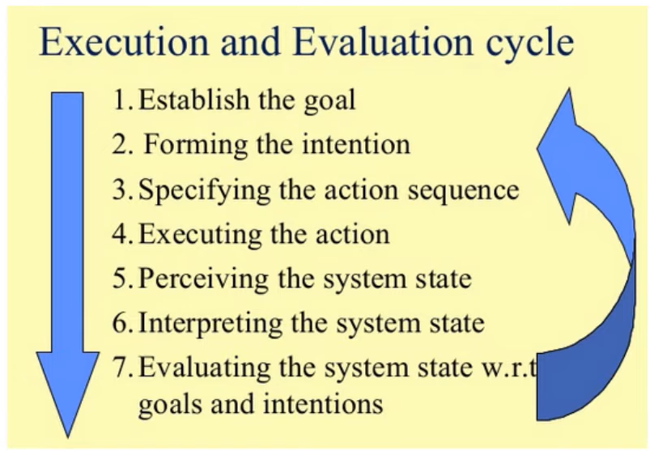

Slide 11

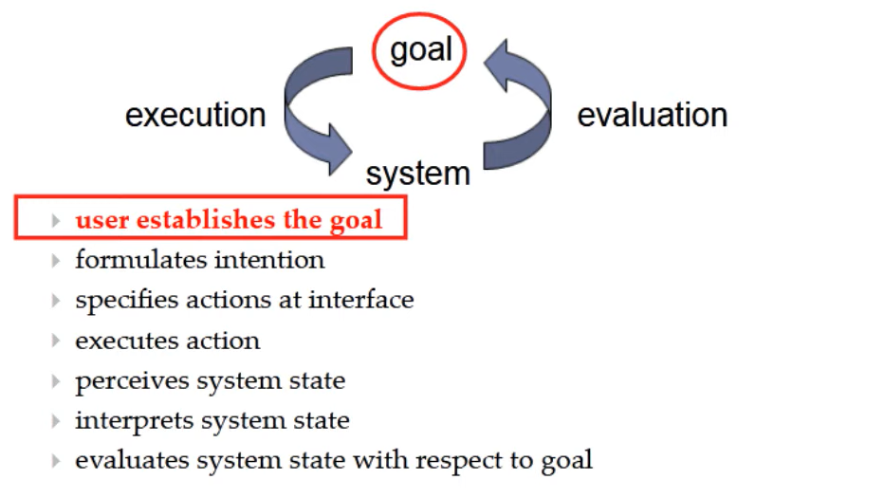

Slide 12
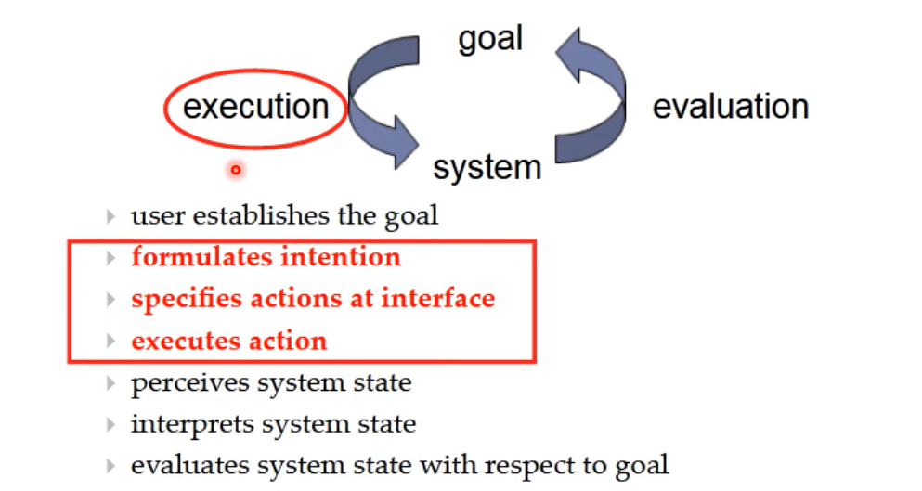

Slide 13
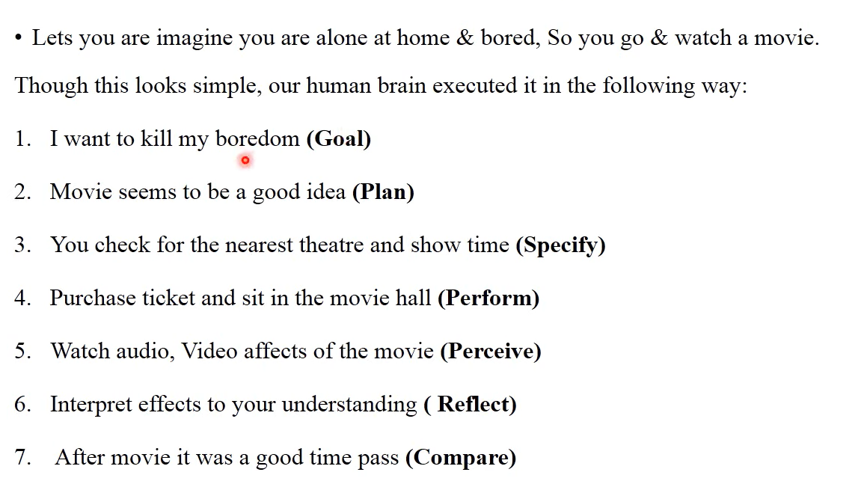

Slide 14

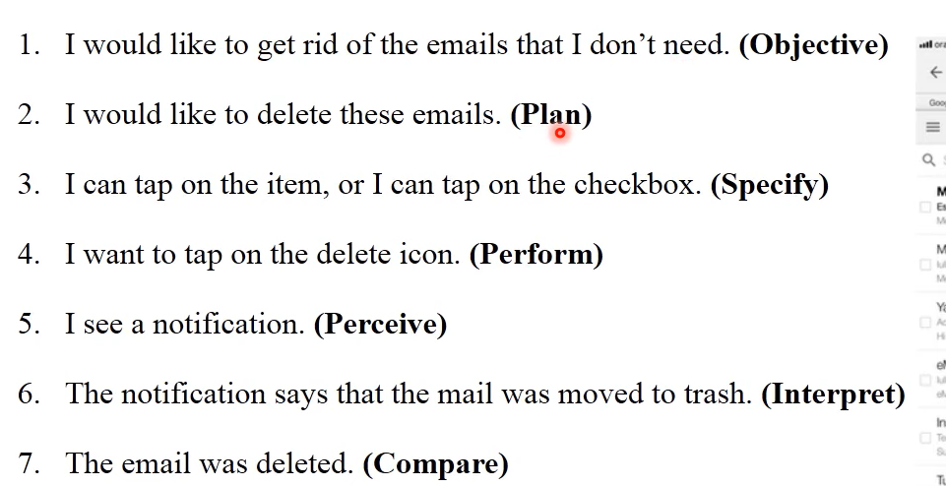

Slide 15
INTERACTION STYLES
Interaction can be seen as a dialog between the computer and the user.
The choice of interface style can have a profound effect on the nature of this dialog.
There are a number of common interface styles including
Command line interface
Menus
Natural language
Question/answer and query dialog
Form-fills and spreadsheets
WIMP
Point and click
Three-dimensional interfaces.

Slide 16
Command line interface
The command line interface was the first interactive dialog style to be commonly used and, in spite of the availability of menu-driven interfaces, it is still widely used.
In some systems the command line is the only way of communicating with the system, especially for remote access using telnet.
Command line interfaces are powerful in that they offer direct access to system functionality.
Commands must be remembered, as no cue is provided in the command line to indicate which command is needed.
They are therefore better for expert users than for novices.
Unfortunately, commands are often obscure and vary across systems, causing confusion to the user and increasing the overhead of learning.

Slide 17
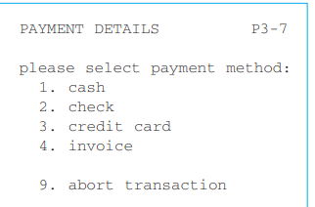
Menus
In a menu-driven interface, the set of options available to the user is displayed on the screen, and selected using the mouse, or numeric or alphabetic keys.
Since the options are visible they are less demanding of the user, relying on recognition
rather than recall.
However, menu options still need to be meaningful and logically grouped to aid recognition.

Slide 18
Natural language
Perhaps the most attractive means of communicating with computers, at least at first glance, is by natural language.
Users, unable to remember a command or lost in a hierarchy of menus, may long for the computer that is able to understand instructions expressed in everyday words!
Unfortunately, however, the ambiguity of natural language makes it very difficult for a machine to understand.
The boy hit the dog with the stick
we cannot be sure whether the boy is using the stick to hit the dog or whether the dog is holding the stick when it is hit.

Slide 19
Question/answer and query dialog
Question and answer dialog is a simple mechanism for providing input to an application in a specific domain.
The user is asked a series of questions (mainly with yes/no responses, multiple choice, or codes) and so is led through the interaction step by step.
An example of this would be web questionnaires

Slide 20
Form-fills and spreadsheets
Form-filling interfaces are used primarily for data entry but can also be useful in data retrieval applications.
Often the form display is based upon an actual form with which the user is familiar, which makes the interface easier to use.
The user works through the form, filling in appropriate values. The data are
then entered into the application in the correct place.
They also require correction facilities, as users may change their minds or make a mistake about the value that belongs in each field.
Spreadsheets are a sophisticated variation of form filling. The spreadsheet comprises a grid of cells, each of which can contain a value or a formula

Slide 21
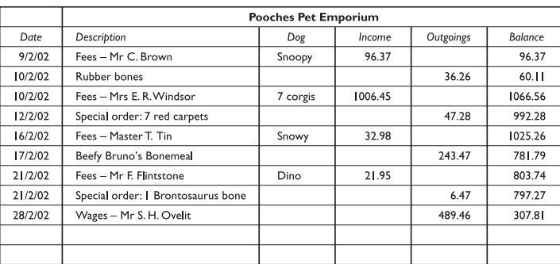
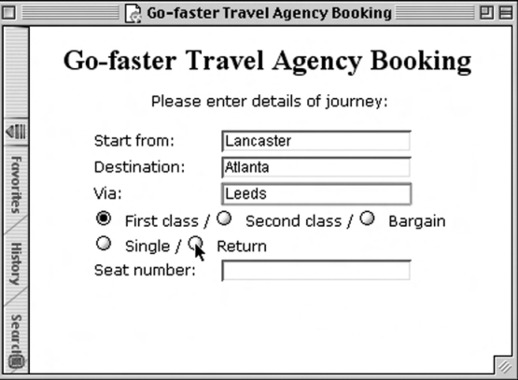
Form-fills and spreadsheets

Slide 22
Point-and-click interfaces
In most multimedia systems and in web browsers, virtually all actions take only a
single click of the mouse button.
You may point at a city on a map and when you click a window opens, showing you tourist information about the city.
You may point at a word in some text and when you click you see a definition of the word.
However, the philosophy is simpler and more closely tied to ideas of hypertext.
In addition, the point-and-click style is not tied to mouse-based interfaces, and is also extensively used in touchscreen information systems.
In this case, it is often combined with a menu-driven interface.

Slide 23
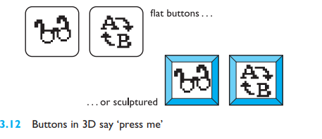
Three-dimensional interfaces
There is an increasing use of three-dimensional effects in user interfaces.
The most obvious example is virtual reality, but VR is only part of a range of 3D techniques available to the interface designer.
A more complex technique uses interfaces with 3D workspaces.
The objects displayed in such systems are usually flat, but are displayed in perspective when at an angle to the viewer and shrink when they are ‘further away’.

Slide 24
The WIMP interface
Currently many common environments for interactive computing are examples of the WIMP interface style, often simply called windowing systems.
WIMP stands for windows, icons, menus and pointers (sometimes windows, icons, mice and pull-down menus).
Examples of WIMP interfaces include Microsoft Windows for IBM PC compatibles, MacOS for Apple Macintosh compatibles and various X Windows-based systems for UNIX.

Slide 25
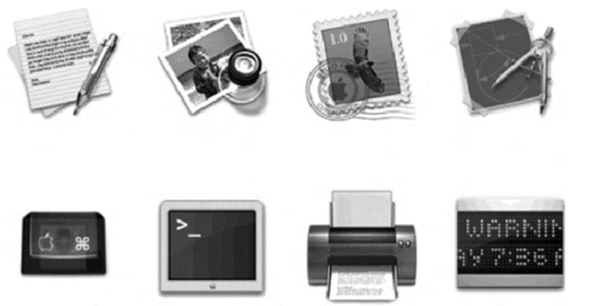
ELEMENTS OF THE WIMP INTERFACE
Windows
Windows are areas of the screen that behave as if they were independent terminals in their own right. A window can usually contain text or graphics, and can be moved or resized.
More than one window can be on a screen at once, allowing separate tasks to be visible at the same time.
Icons
Windows can be closed and lost for ever, or they can be shrunk to
some very reduced representation.
A small picture is used to represent a closed window, and
this representation is known as an icon.

Slide 26
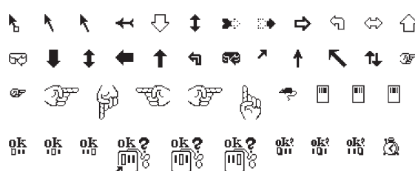
Pointers
The pointer is an important component of the WIMP interface, since the interaction style required by WIMP relies very much on pointing and selecting things such as icons.
The mouse provides an input device capable of such tasks, although joysticks and trackballs are other alternatives.

Slide 27
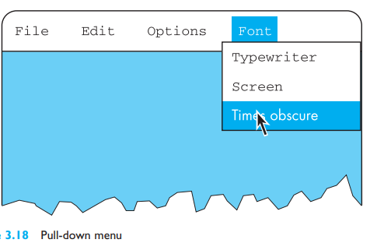
Menus
The last main feature of windowing systems is the menu, an interaction technique that is common across many non-windowing systems as well.
A menu presents a choice of operations or services that can be performed by the system at a given time.

